Slide 1
British Airways
Predictive model and its results
2022-11-09

Slide 2

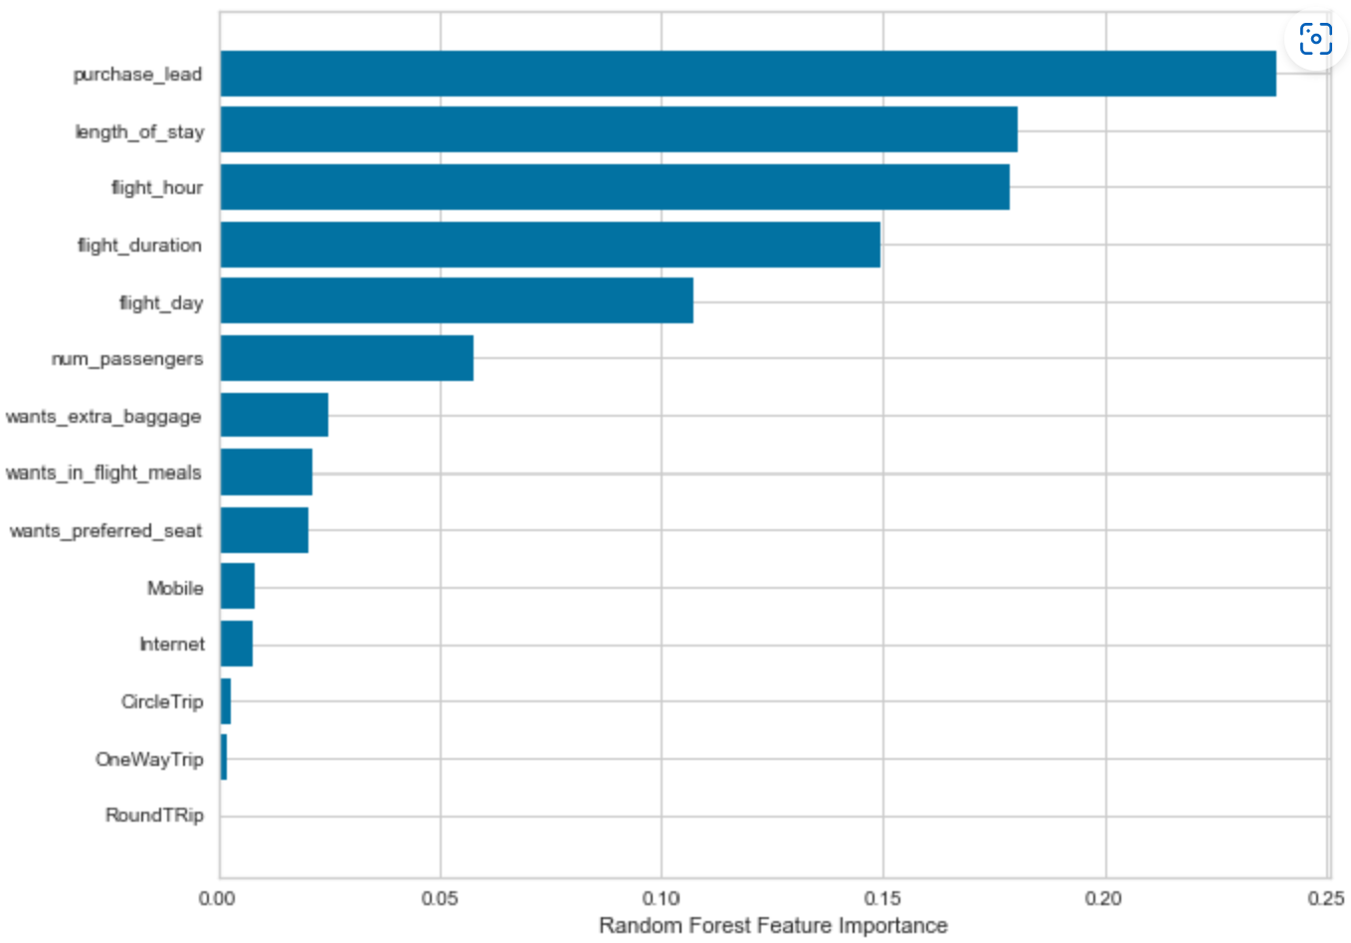

Predictive modelling results
Recall Rate
60%
Precision
61%
Chance of predicting true successful bookings.
Will be predicted as actually completed bookings out of all successfully completed bookings.
Accuracy
62%
62% Chance of predicting true incomplete bookings correctly.
We are focused on the issue of not accurately predicting successful bookings. An imbalanced dataset leads to higher accuracy but fails to effectively predict the successful bookings. The dataset was balanced with 8k labeled as incomplete bookings and 7k labeled as complete bookings.
Top features that can drive successful flight bookings.

Slide 3
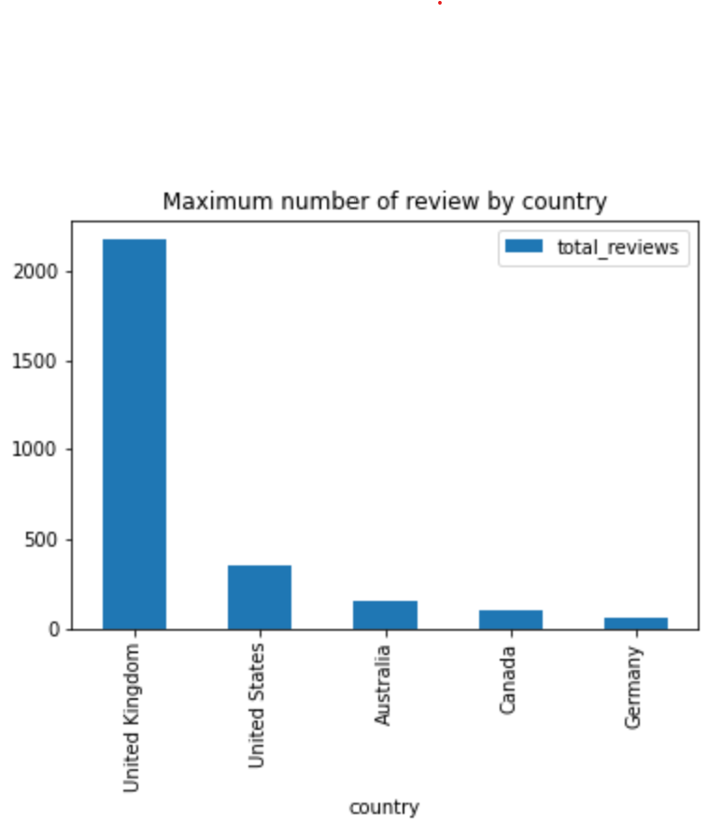

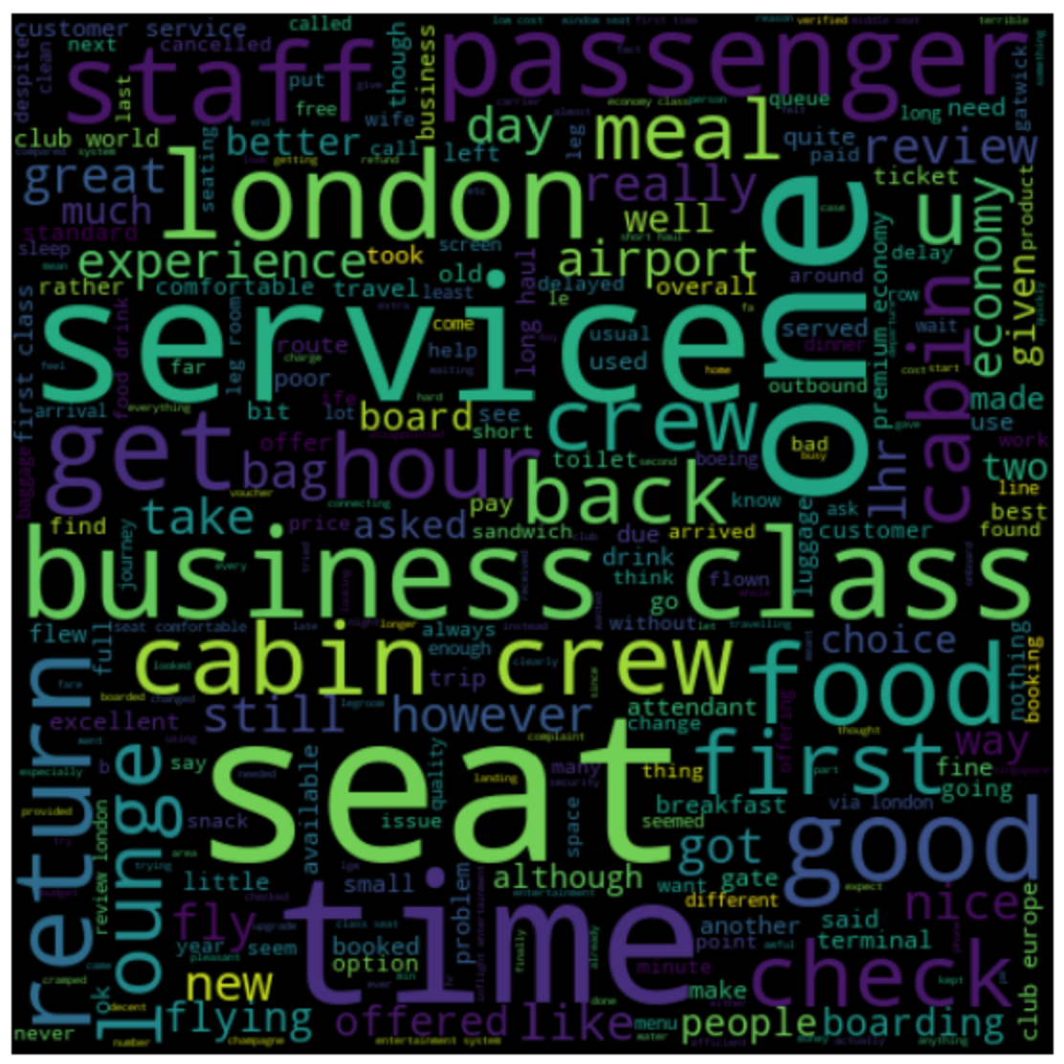

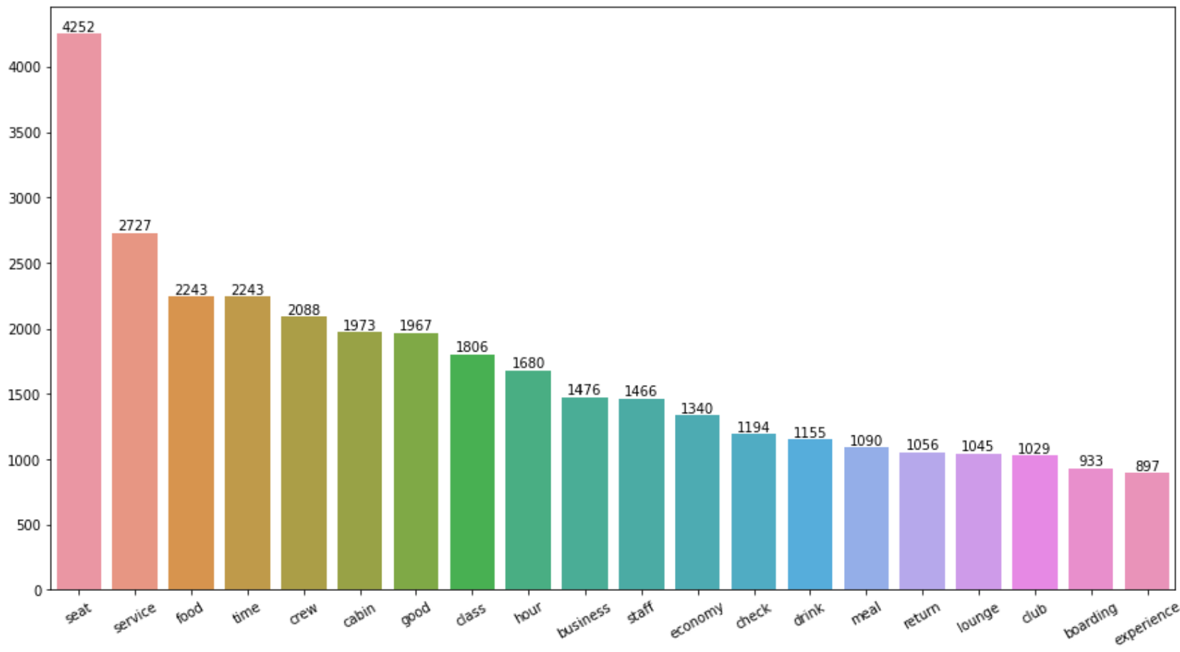
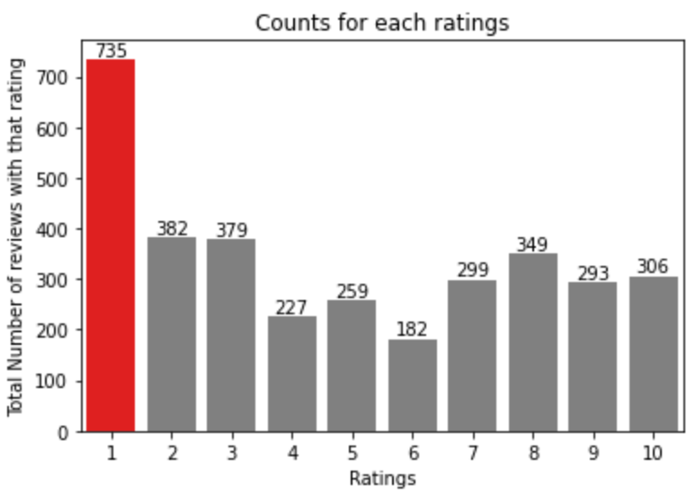
3411 Total reviews
collected
Key metrics
Average Overall Rating
4.84 /5
All Customers liked Cabin crew service and staff, general economy seats. Many travelled in Business class.
Focus on – Economy class service, seats, enhance inflight entertainment experience and importantly Delays.
Enhance the experience of business class, it seems customers want value for money. Improve Customer service on refund requests and process.
Reviews from 69 Countries
What customers are happy and unsatisfied about for different ratings class:
7-10 ratings wrote about comfortable seats, good inflight entertainment, descent food quality.
4-6 ratings faced problem with small entertainment screen, long passport check queue, bad business class experience.
1-3 ratings wrote dissatisfaction on congested middle seat and small screen while they liked the seats and the food.

